Slide 1


Enter Your Demo Text Here. Try To Keep It Short And Remove This Dummy Text
Build & Share Delightful Machine Learning Apps

Slide 2



Team Members
Vahid Ebrahimian
Mahboobe Askarian
Heading an liar of the group
Teacher and Data Senior
Mohammad Javadpur
AI Senior & Data Scientist

Slide 3
Introduction to GUI libraries in PYTHON
Tkinter
PyQt
PySide
wxPython
Kivy
01
02
Introduction to Gradio library
What is Gradio?
Why use Gradio?
Features of Gradio
Table of Content
1
03
Installation and Setup
Installing Gradio
Setting up a development environment
04
Building Interactive Interfaces
Creating input/output components
Using custom components
Adding styling and layout

Slide 4
Connecting Models to Gradio
Integrating machine learning models
Working with different model types
Handling model inputs and outputs
05
06
Deploying Gradio Applications
Hosting on local and remote servers
Using cloud deployment platforms
Best practices for deployment
Table of Content
2
07
Advanced Topics
Handling errors and debugging
Scaling Gradio applications
Working with Gradio API
08
Conclusion and Resources
Recap of Gradio features and benefits
Additional resources and documentation

Slide 5
Welcome Message From Kaizen
Gradio is a great library for quickly creating interactive web applications for machine learning models.

Slide 6
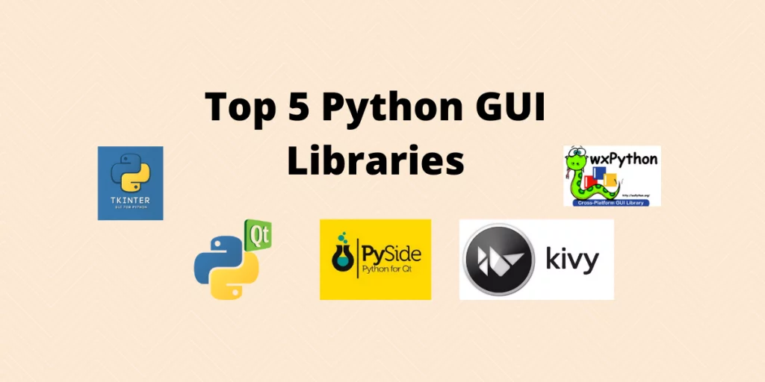
What is a GUI?
A GUI or a graphical user interface is an interactive environment to take responses from users on various situations such as forms, documents, tests, etc. It provides the user with a good interactive screen than a traditional Command Line Interface (CLI).

Slide 7
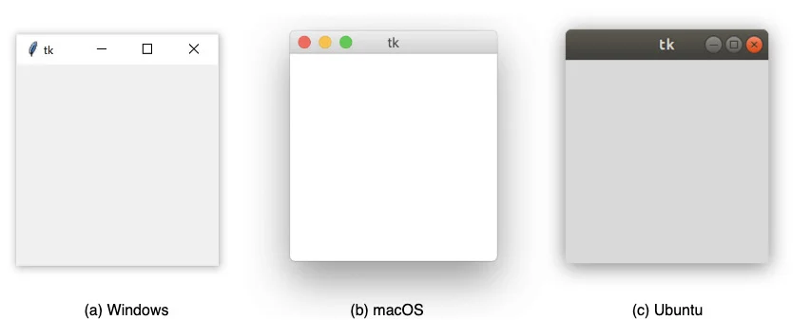
Tkinter
What is Tkinter used for ?
Another GUI framework is called Tkinter. Tkinter is one of the most popular Python GUI libraries for developing desktop applications. It’s a combination of the TK and python standard GUI framework.
Tkinter provides diverse widgets such as labels, buttons, textboxes,
checkboxes that are used in a graphical user interface application.
import tkinter as tk
window = tk.Tk()

Slide 8
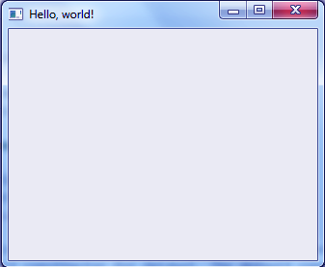
PyQT5
What is QT used for ?
PyQT5 is a graphical user interface (GUI) framework for Python. It is very popular among developers and the GUI can be created by coding or a QT designer. A QT Development framework is a visual framework that allows drag and drop of widgets to build user interfaces.
pip install pyqt5
import PyQt5
>>> import sys
>>> from PyQt5.QtWidgets import QApplication, QWidget
>>> app=QApplication(sys.argv)
>>> root=QWidget()
>>> root.resize(320,240)
>>> root.setWindowTitle('Hello, world!')
>>> root.show()

Slide 9
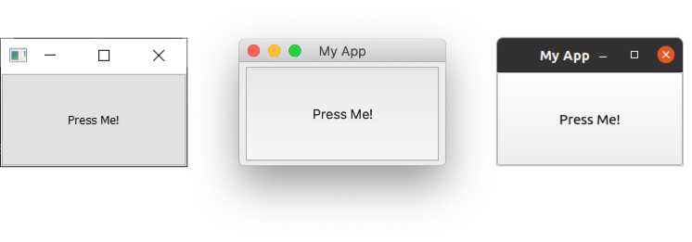
PySide
What is PySide used for ?
PySide, also known as Qt for Python, is a Python library for creating GUI applications using the Qt toolkit. PySide is the official binding for Qt on Python and is now developed by The Qt Company itself.
import sys
from PySide6.QtCore import QSize, Qt
from PySide6.QtWidgets import QApplication, QMainWindow, QPushButton
class MainWindow(QMainWindow):
def __init__(self):
super().__init__()
self.setWindowTitle("My App")
button = QPushButton("Press Me!")
self.setCentralWidget(button)
app = QApplication(sys.argv)
window = MainWindow()
window.show()
app.exec_()

Slide 10
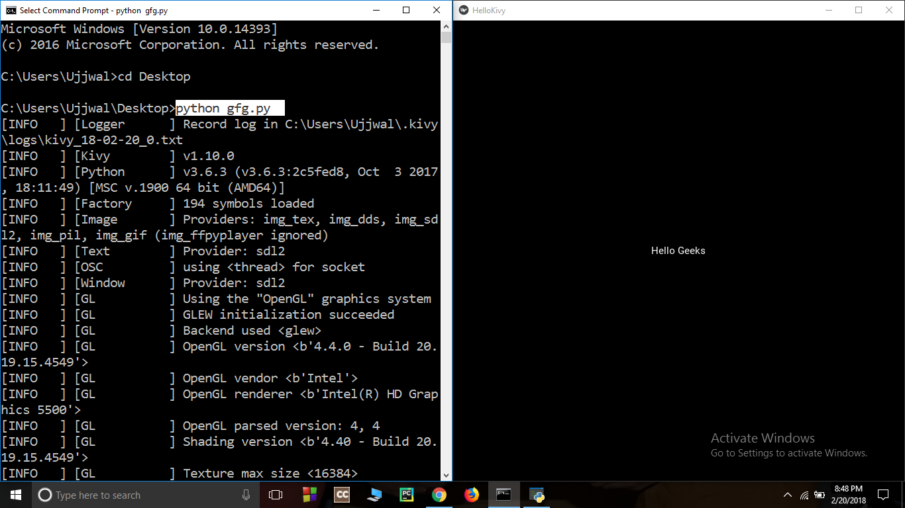
Kivy
What is Kivy used for ?
Kivy is an open source, multi-platform application development framework for Python. It allows us to develop multi-platform applications on various platforms such as Windows, Linux, Android, macOS, iOS, and Raspberry Pi.
import kivy
kivy.require('1.10.0')
from kivy.app import App
from kivy.uix.button Label
import
class HelloKivy(App):
def build(self):
return Label(text ="Hello Geeks")
helloKivy = HelloKivy()
helloKivy.run()

Slide 11
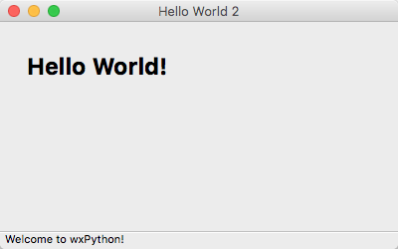
wxPython
What is wxPython used for?
wxPython is a cross-platform GUI toolkit for the Python programming language. It allows Python programmers to create programs with a robust, highly functional graphical user interface, simply and easily.
import wx
app = wx.App()
frm = wx.Frame(None, title="Hello World")
frm.Show()
app.MainLoop() torial/

Slide 12
What is Gradio?
Gradio
Gradio is an open-source Python library that is used to build machine learning and data science demos and web applications.
With Gradio, you can quickly create a beautiful user interface around your machine learning models or data science workflow and let people "try it out" by dragging-and-dropping in their own images, pasting text, recording their own voice, and interacting with your demo, all through the browser.

Slide 13
Why use Gradio?
Gradio is useful for:
Demoing
your machine learning models for clients/collaborators/users/students.
Deploying
your models quickly with automatic shareable links and getting feedback on model performance.
Debugging
your model interactively during development using built-in manipulation and interpretation tools.

Slide 14
Features of Gradio:
There are several reasons why you might want to use Gradio:
1. Shareability: Gradio provides an easy way to share your machine learning models and other functions with others, without requiring them to install any additional software or dependencies. This can be especially useful if you want to share your models with non-technical users or people who don't have the same development environment as you.
2. Customizable Interface: Gradio allows you to create a custom interface for your model that matches the style and branding of your application or website. This can help to improve the user experience and make your model more accessible to a wider audience.
3. Real-time Feedback: Gradio provides real-time feedback on the output of your model, allowing users to see the results of their input immediately. This can be especially useful for debugging and testing your model.
4. Multi-Framework Support: Gradio supports a wide range of popular machine learning frameworks, including TensorFlow, PyTorch, and scikit-learn. This means that you can use Gradio with the framework of your choice, without having to rewrite your code.
5. Multi-Language Support: Gradio supports multiple programming languages, including Python, R, and Julia. This means that you can use Gradio with the language of your choice, without having to learn a new language or switch to a different language.

Slide 15
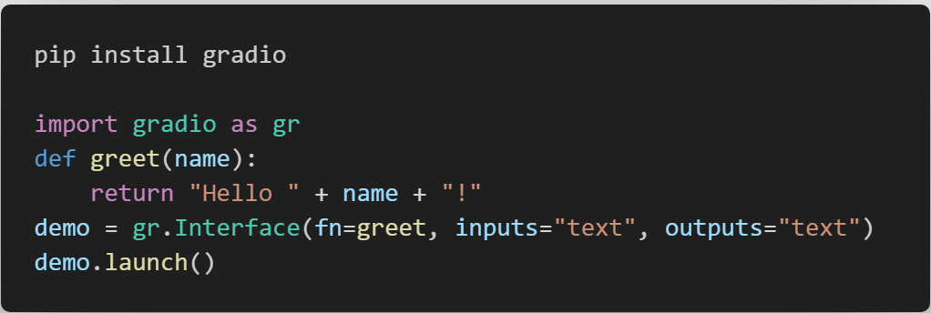
Installing Gradio:

Slide 16
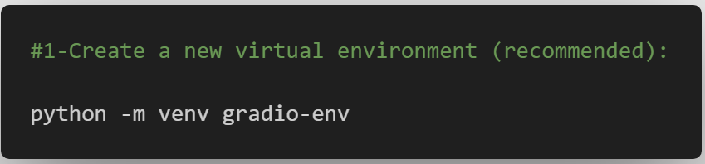
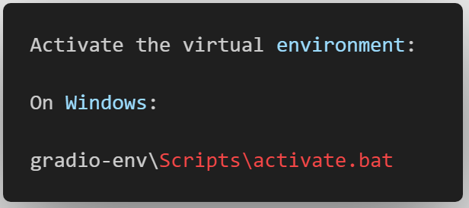
Setting up a development environment Gradio
To set up a development environment for Gradio, you will need to have Python 3.8 or later installed on your computer. Here are the steps to set up a development environment for Gradio:

Slide 17
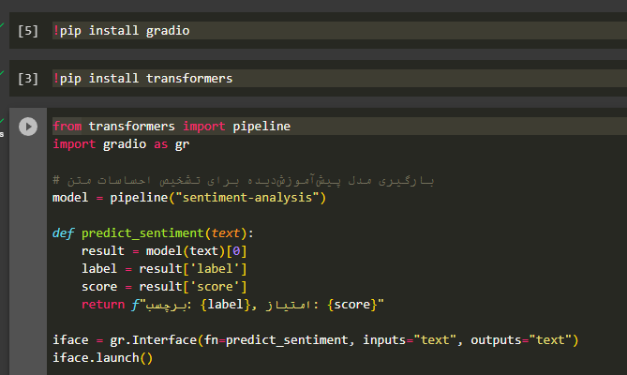
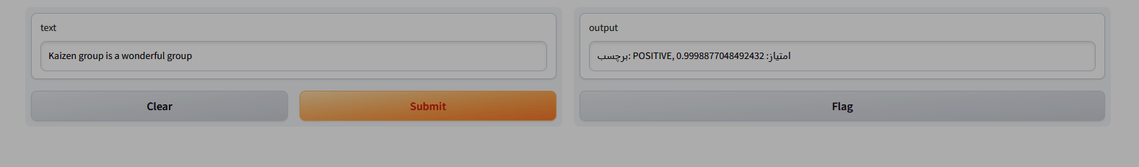
Hugging Face And Gradio
Hugging Face provides a wide range of pre-trained models for various NLP tasks, including sentiment analysis, text classification, machine translation, and more. These models are available in popular architectures such as BERT, GPT, RoBERTa, and others. Hugging Face also offers a convenient Python library called "transformers" that allows you to easily load, use, and fine-tune these pre-trained models.
On the other hand, Gradio is a user interface library for ML models. It enables you to quickly create and deploy web-based interfaces for your ML models, including NLP models. Gradio simplifies the process of building interactive interfaces, allowing users to interact with your models by entering text, making selections, and visualizing the results.
By combining Hugging Face and Gradio, you can build powerful NLP applications with user-friendly interfaces. For example, you can use a pre-trained sentiment analysis model from Hugging Face and create a Gradio interface where users can input text and instantly see the sentiment analysis results.

Slide 18
Recap of Gradio features and benefits
Features:
Customizable input and output forms:
Users can create custom forms for their models, allowing them to accept a wide range of inputs, including images, text, and other data types.
Real-time feedback:
Gradio provides real-time feedback on the output of the model, allowing users to see the results of their input immediately.
Customizable UI:
The Gradio interface can be customized to match the style and branding of the user's application or website.
Shareable:
Gradio provides a simple way to share models with others, without requiring any additional software or dependencies.
Multi-Framework Support:
Gradio supports a wide range of popular machine learning frameworks, including TensorFlow, PyTorch, and scikit-learn.
Multi-Language Support:
Gradio supports multiple programming languages, including Python, R, and Julia.
Collaboration:
Gradio allows multiple users to collaborate on a shared model, allowing them to work together to improve the model's performance or create new models from scratch.

Slide 19
Recap of Gradio features and benefits
Benefits:
Ease of use:
Gradio provides an easy-to-use interface for creating web-based interfaces for machine learning models and other functions.
Customizability:
Gradio allows users to create custom interfaces that match the specific needs of their application or website.
Shareability:
Gradio provides a simple way to share models with others, without requiring any additional software or dependencies.
Real-time feedback:
Gradio provides real-time feedback on the output of the model, allowing users to see the results of their input immediately.
Multi-Framework Support:
Gradio supports a wide range of popular machine learning frameworks, allowing users to use the framework of their choice.
Multi-Language Support:
Gradio supports multiple programming languages, allowing users to use the language of their choice.
Collaboration:
Gradio allows multiple users to collaborate on a shared model, allowing them to work together to improve the model's performance or create new models from scratch.

Slide 20
Resources and Documentation for Gradio:
https://www.askpython.com/python-modules/top-best-python-gui-libraries
https://realpython.com/python-gui-tkinter/
https://data-flair.training/blogs/python-pyqt5-tutorial/
https://www.pythonguis.com/pyside6-tutorial/
https://www.geeksforgeeks.org/introduction-to-kivy/

Slide 21
Gradio Documentation: The official Gradio documentation provides a comprehensive guide for getting started with Gradio, including tutorials, API reference, and examples. You can visit the documentation at https://gradio.app/docs/. ↗
Gradio GitHub Repository: The Gradio GitHub repository contains the source code for Gradio, including examples, documentation, and issue tracking. You can visit the repository at https://github.com/gradio-app/gradio. ↗
Gradio YouTube Channel: The Gradio YouTube channel contains a series of video tutorials and demos of Gradio features and functionality. You can visit the channel at https://www.youtube.com/channel/UCdyjiMAZMqyChLxXrSPk7iQ. ↗
Thank You

Slide 22
Gradio Gitter Community: The Gradio Gitter community provides a forum for developers to ask questions, share ideas, and discuss issues related to Gradio. You can join the community at https://gitter.im/gradio-app/community. ↗
Gradio Blog: The Gradio blog contains articles and tutorials on various topics related to Gradio, including tips and tricks, use cases, and best practices. You can visit the blog at https://gradio.app/blog/. ↗

Slide 23
Hosting on a local server
1
Install Gradio and the dependencies for your application
2
Create a file called `app.py` that contains your Gradio application
3
Run the following command to start a Gradio server on your local machine:
gradio run app.py
`http://localhost:8000`

Slide 24
Hosting on a remote server
1
2
Rent a server from a cloud provider such as AWS, Azure, or Google Cloud Platform.
Install Gradio and the dependencies for your application on the remote server.
3
Create a `Dockerfile` that describes how to build and deploy your application.
4
Build the Docker image by running the following command:
docker build -t my-app
5
Deploy the Docker image to your remote server by running the following command:
docker run -p 8000:8000 my-app
`http://<your_server_ip>:8000`

Slide 25
Best practices for deployment
1
2
Use a cloud deployment platform.
Use a containerization tool. Like Docker
3
Use a continuous integration and continuous delivery (CI/CD) pipeline.
4
Test your application thoroughly.
5
6
Monitor your application
Keep your application up to date

Slide 26

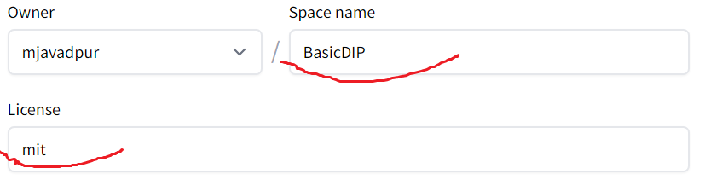
Deployment Sample 1/5
1
Login on https://huggingface.co/
2
Go to: https://huggingface.co/spaces
3
Click on “Create new Space”
4
Write Space name and Select License

Slide 27
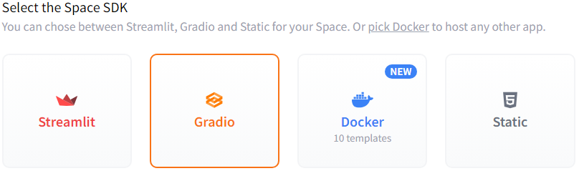

Deployment Sample 2/5
5
Select Gradio as SDK
6
Then click on Create Space button

Slide 28
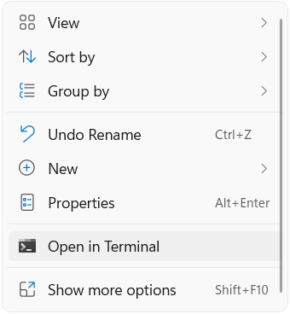
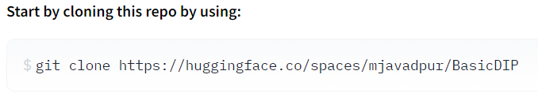
Deployment Sample 3/5
7
Write click on project folder in your computer and click on “Open in Terminal”
Copy the git code
8
9
Paste git code and enter

Slide 29
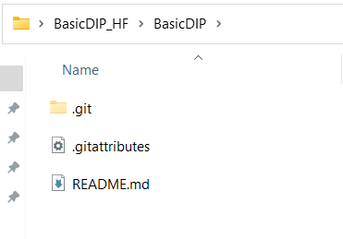

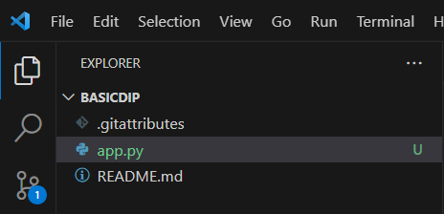
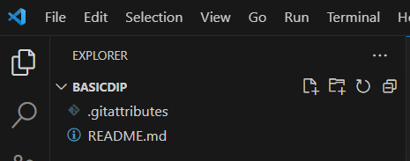
Deployment Sample 4/5
10
Folder and files cloned:
11
In VSCode select File->Open Folder
13
Project entry point is app.py
Select project folder on local to open like this
12

Slide 30
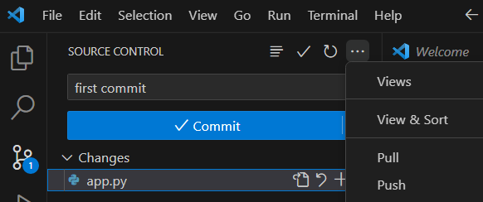
Deployment Sample 5/5
14
After debug, Run and Test your codes
15
Commit and Push codes
In first time, Request HF username and password to push
16
Now go to your project address on HF and use your app.

Slide 31
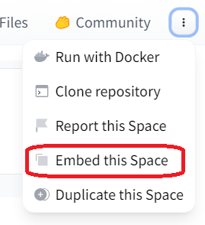
Embedding Hosted Spaces 1/4
Once you have hosted your app on Hugging Face Spaces (or on your own server), you may want to embed the demo on a different website, such as your blog or your portfolio.
You can find quick links to both options directly on the Hugging Face Space page, in the “Embed this Space” dropdown option
1
2
There are two ways to embed your Gradio demos.
1. Embedding with Web Components
2. Embedding with IFrames

Slide 32
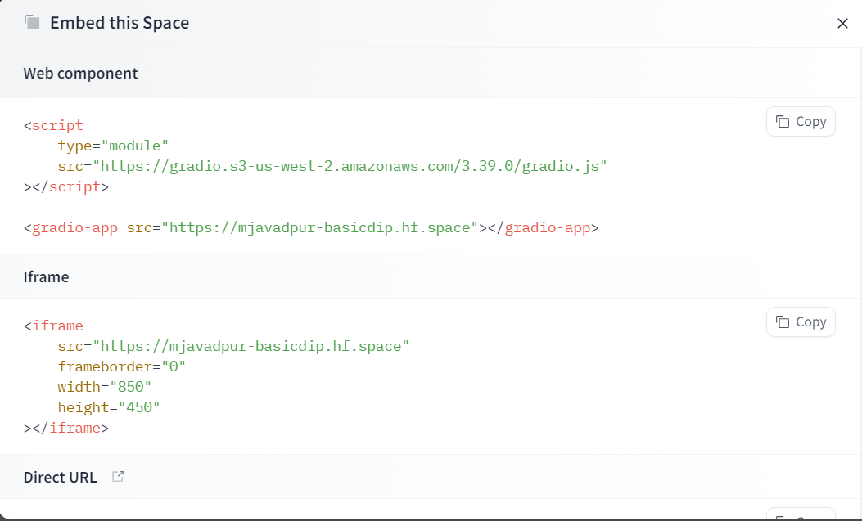
Embedding Hosted Spaces 2/4

Slide 33
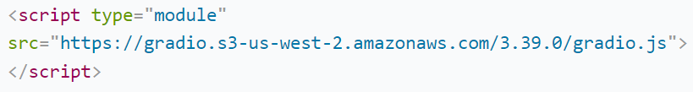
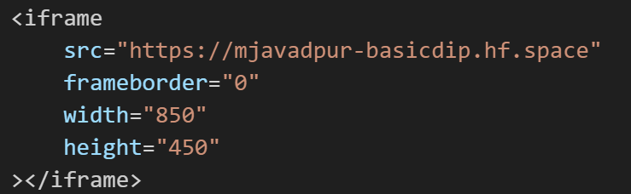
1. Embedding with Web Components 3/4
1
Import the gradio JS library into into your site by adding the script below in your site (replace 3.39.0 in the URL with the library version of Gradio you are using).
Add below code into element where you want to place the app :
2

Slide 34
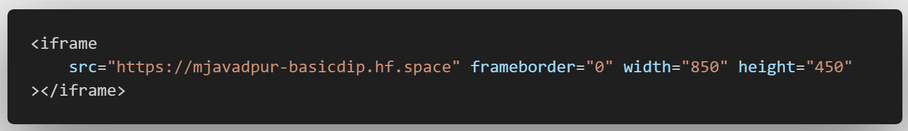
2. Embedding with IFrames 4/4
To embed with IFrames instead (if you cannot add javascript to your website, for example), add this element

Slide 35
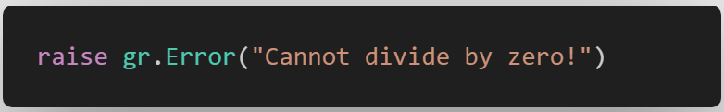

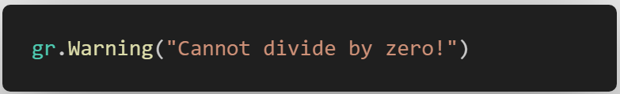
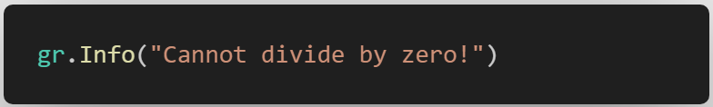
Handling errors and debugging
1
Gradio.Error
2
Warning
3
Info

Slide 36
Scaling Gradio applications
1
Use a hosting service like Heroku or AWS Elastic Beanstalk.
These services will automatically scale your application up or down depending on the number of users.
Use a distributed computing framework like Ray Serve.
Ray Serve can parallelize the inference requests for your model, which can significantly improve the performance of your application.
2
3
Use a caching mechanism to store the results of previous inference requests.
This can help to reduce the load on your model and improve the performance of your application.
4
Use a load balancer to distribute the traffic to your application across multiple servers. This can help to improve the performance of your application by reducing the latency of individual requests.

Slide 37
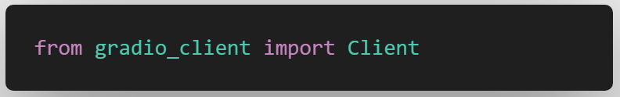
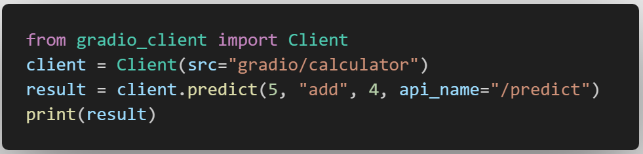
Working with Gradio API
The Gradio client(gradio_client) makes it very easy to use any Gradio app as an API.
1
Client:
The main Client class for the Python client.
This class is used to connect to a remote Gradio app and call its API endpoints.
2
Predict:
Calls the Gradio API and returns the result .

Slide 38
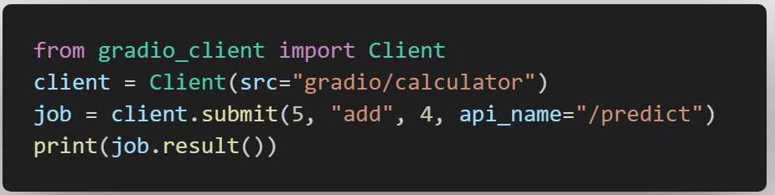
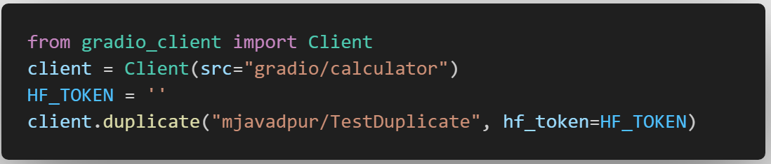
Working with Gradio API
submit:
Creates and returns a Job object which calls the Gradio API in a background thread.
3
duplicate:
Duplicates a Hugging Face Space under your account and returns a Client object for the new Space.
4

Slide 39
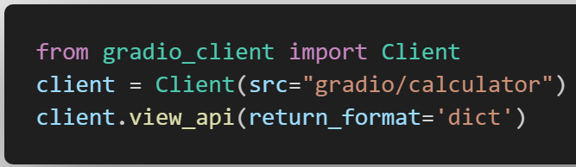
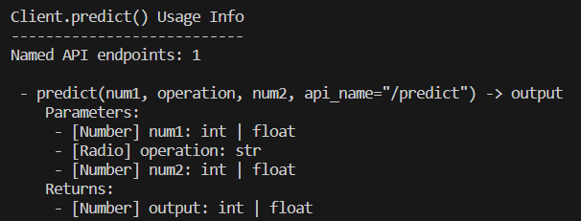
Working with Gradio API
view_api:
Prints the usage info for the API.
5

Slide 40
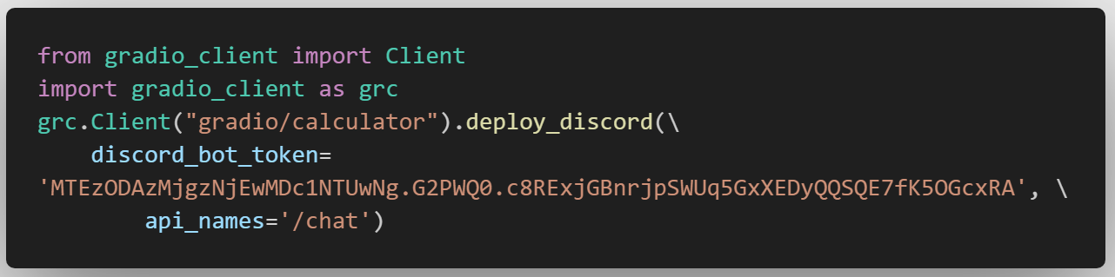
Working with Gradio API
6
deploy_discord:
Deploy the upstream app as a discord bot. Currently only supports gr.ChatInterface.

Slide 41
Thank You
Enter Your Original Text Here. Try To Keep It
Short And Remove Dummy Text

